Slide 1
Packet Reassembly with Python
We will learn about:
Review of Packets
Packet Reassembly
Payload Extraction

Slide 2
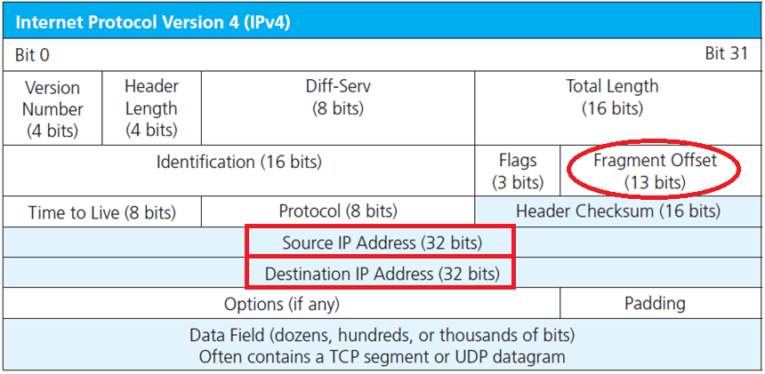
Review of Packets

Slide 3
Review of Packets
It is important to recall each packet has a source IP address, destination IP address and Fragment Offset.
Source: where it came from
Destination: where it goes to

Slide 4
Fragment Offset
The Fragment Offset field (13 bits) is used to indicate the starting position of the data in the fragment in relation to the start of the data in the original packet.
This information is used to reassemble the data from all the fragments (whether they arrive in order or not).

Slide 5
Fragment Offset
In the first fragment the offset is 0. The data in this packet starts in the same place as the data in the original packet.
In subsequent fragments, the value is the offset of the data the fragment contains from the beginning of the data in the first fragment (offset 0), in 8 byte ‘blocks’

Slide 6
Fragment Offset
If a packet containing 800 bytes of data is split into two equal fragments carrying 400 bytes of data, the fragment offset of the first fragment is 0, and the second fragment is 50 (400/8).
The offset value must be the number of 8-byte blocks of data, which means the data in the prior fragment must be a multiple of 8 bytes.

Slide 7
Fragment Offset
The last fragment can carry data that isn’t a multiple of 8 bytes as there won’t be a further fragment with an offset that must meet the 8-byte ‘rule’.

Slide 8
Packet Reassembly
Overlapping IP fragments can be used by attackers to hide their nefarious intentions from intrusion detection system and analysts.

Slide 9
IP Fragment Overlap Exploit
From Wikipedia: (1)
The IP fragment overlapped exploit occurs when two fragments contained within the same IP packet have offsets that indicate that they overlap each other in positioning within the packet.
This could mean that either fragment A is being completely overwritten by fragment B, or that fragment A is partially being overwritten by fragment B.

Slide 10
IP Fragment Overlap Exploit
From Wikipedia: (2)
Some operating systems do not properly handle fragments that overlap in this manner and may throw exceptions or behave in other undesirable ways upon receipt of overlapping fragments.
This is the basis for the teardrop attack.

Slide 11
IP Fragment Overlap Exploit
From Wikipedia: (3)
Overlapping fragments may also be used in an attempt to bypass Intrusion Detection Systems (IDS).
In this exploit, part of an attack is sent in fragments along with additional random data; future fragments may overwrite the random data with the remainder of the attack. If the completed packet is not properly reassembled at the IDS, the attack will go undetected.

Slide 12
Packet Reassembly
Normally, packet fragmentation will be performed by a router when the size of a packet exceeds the link layers MTU (Maximum Transmission Unit) of the upstream network.

Slide 13
Packet Reassembly
The receiving host is responsible for reassembling those fragmented packets and passing it up the TCP stack to the proper application.
The regulating RFC’s do not specify what the receiving host is supposed to do when the fragments it receives are retransmitted or overlap one another.

Slide 14
Packet Reassembly
No guidance is given as to whether or not the host should favor the first “retransmitted” fragment it receives, the second “retransmitted” fragment or the last.
Should it favor overlapping fragments with the lowest offset or the highest?

Slide 15
Packet Reassembly
As a result, different operating systems handle overlapping fragments in different ways.
Depending on how the overlapping fragments are interpreted, malware is able to make it through the network undetected

Slide 16
Packet Reassembly
Imagine that we send the following 6 IP fragments that overlap in the following ways:
Each fragment is 8 bytes in length which is the minimum size of a fragment. We will set the payload to be eight ASCII 1s for packet 1, 2s for packet 2 and so on.

Slide 17
Packet Reassembly
Visualization available below (+3 slides)
Fragment 1 has an offset of zero and has a payload length of 24 bytes so that that fills fragment positions 0, 1 (offset 8) and 2 (offset 16).
Fragment 2 begins at offset 24 and has a length of 16 bytes so that it fills fragment positions 4 and 5.

Slide 18
Packet Reassembly
Fragment 3 has an offset of 48, length of 24 bytes and fills fragment positions 6, 7 and 8.
Fragment 4 has an offset of 8, a length of 32 and fills fragment positions 1 (offset 8), 2 (offset 16), 3 (offset 24) and 4 (offset 32) causing it to overlapping part of fragment positions 1 and 2.

Slide 19
Packet Reassembly
Fragment 5 has an offset of 48 and fills positions 6, 7 and 8 so that it perfectly overlaps fragment 3.
Fragment 6 has an offset of 72 and fills fragment positions 9, 0xa and 0xb.

Slide 20
Packet Reassembly
Visually it would look like this:

Slide 21
Packet Reassembly
Depending upon whether the reassembling host wants to favor the packets that arrive first or last or favor the packets with the lowest offset the fragments may end up in one of the 5 possible combinations.
These combinations have been named First, Last, Linux, BSD and BSD-Right.

Slide 22
Packet Reassembly
Reassembled using policy: First (Windows, SUN, MacOS, HPUX)
Reassembled using policy: Last/RFC791 (Cisco)
Reassembled using policy: Linux (Linux)
Reassembled using policy: BSD (AIX, FreeBSD, HPUX, VMS)
Reassembled using policy: BSD-Right (HP Jet Direct)

Slide 23
Packet Reassembly
These inconsistencies allow attackers to put a malicious payload in an overlapped fragment.
If an IDS (Intrusion Detection System) and the host reassemble the packets differently, the IDS will not see the packets, but the reassembling host will.

Slide 24
Packet Reassembly
Although many IDS’s attempt to mitigate this risk by reassembling the packets in multiple ways, such as SNORT’s frag3 preprocessor, the analyst is given very little insight to what happens inside the reassembly engine.

Slide 25
Packet Reassembly
This can lead to the analyst incorrectly dismissing an attack as an IDS false negative.
Consider the following scenario:
The attacker sends a crafted packet that contains both a Linux Exploit and a Windows Exploit to a vulnerable Windows target.

Slide 26
Packet Reassembly
The IDS has an intelligent reassembly engine and successfully detects that exploitation of the host.
The Analyst then sees the alert and examines the full packet capture where he finds a Linux exploit targeting a Windows host and incorrectly dismisses it as a false positive.

Slide 27
Packet Reassembly
To avoid this situation an analyst has to be aware of the limitations of his tool sets and find or create new tools to properly analyze these attacks.

Slide 28
Packet Reassembly
If an analyst uses Wireshark to extract the payload of fragmented packets, he will see neither the Linux payload NOR the Windows payload. Instead, he will see a combination of the two.
Wireshark uses the BSD reassembly policy when putting fragments back together.

Slide 29
Packet Reassembly
How does an analyst know exactly what was launched against their system?

Slide 30
Packet Reassembly

Slide 31
Packet Reassembly
One Possible Solution:
Tools such as scapy and Python can be used to quickly reassemble packets in each of the differently combinations used by modern operating systems to get a better understanding of what the attacker may have intended to exploit.

Slide 32
Packet Reassembly
Over the next section, we will examine how to recreate the reassembly engines as they are implemented by various operating systems. Then, as analysts, we can use these techniques to peer behind the curtain and see how our reassembly engines would see that attackers’ packets.

Slide 33
Packet Reassembly
Understanding the techniques used by the attacker will give us greater insight to the skill of our adversary and help us identify attacks that our automated reassembly engines might overlook.

Slide 34
Premade Reassembly Engine
Before delving into the considerations and how to’s of packet reassembly, here is a link to a repository containing source code for a prebuilt assembler tool and sample packet captures for demo & testing:
https://github.com/MarkBaggett/reassembler

Slide 35
Writing a Fragment Reassembly Engine
Writing the IP fragmentation engines in our TCP stack is no easy task.
Fortunately, we do not have to deal with many of the difficulties the authors of programs like Wireshark do.
We don’t have to worry about:
Reassembly time-out
TTL’s
Memory management
Etc.

Slide 36
Writing a Fragment Reassembly Engine
We are reading our packets from stored packet captures.
This gives us another advantage over reassembling live packets in that we have all the packets in our possession and can reorder them as needed before processing them.

Slide 37
Writing a Fragment Reassembly Engine
To reassemble the packets, we will allocate a buffer in memory and then write each fragment to the buffer based allowing fragments to overwrite existing data.
Using this method, the last fragments that we process will overwrite any existing data in the buffer.

Slide 38
Writing a Fragment Reassembly Engine
To reassemble packets as each of the different reassembly policies we will just have to reorder our packet before we process them.

Slide 39
The “Last/RFC791” Policy
To process packets according to the “LAST/RFC791” policy, we just need to process packets from the first one we received until the last in chronological order.
Since subsequent overlapping fragments will overwrite the previous packets, we are favoring the LAST packet to arrive.

Slide 40
The “First” Policy
To process packets according to the “FIRST” policy, we process the same packets in reverse order filling the buffer with the last packet to arrive, then the 2nd to last etc.
The first packet to arrive will overwrite any data that was written in the buffer by later packets thus favoring the FIRST packets.

Slide 41
Writing a Fragment Reassembly Engine
Python’s StringIO module provides us with a good data structure to use as our buffer for the reassembled fragments. We can use StringIO’s seek() method to set the location in the buffer to the fragments offset.

Slide 42
Writing a Fragment Reassembly Engine
Next, we use the write() method to put our data in the buffer. After we have processed all the fragments, we can use the getvalue() method to retrieve the contents of our completed fragment payload.

Slide 43
Writing a Fragment Reassembly Engine
Scapy allows us to quicky and easily tear apart packets and get to the fields you are interested in. By following a variable containing a packet with [protocol] and .field you can pull the contents of various fields from each packet.
For example, to examine the IP ID field of a given packet we can address the variable containing the packet as variableName[IP].id.
This tells scapy you want the value assigned to the ‘id’ field in the ‘IP’ layer of the packet.

Slide 44
Writing a Fragment Reassembly Engine
The field we are interested in is the [IP].frag which contains the fragment offset of the current fragment and the payload of each of the fragmented packets.
The fragment offset will be the number of bytes into fragment chain that the payload bytes should be written.

Slide 45
Writing a Fragment Reassembly Engine
The scapy frag field is a fragment position not the byte offset.
To get the byte offset we multiply by 8 (8 bytes in the smallest fragment).
Then using the StringIO.seek() method we place the pointer into the buffer at the location where the payload should be written.
Using a FOR loop to step through each packet we have a simple reassembly engine.

Slide 46
Writing a Fragment Reassembly Engine
Then using the StringIO.seek() method, we place the pointer into the buffer at the location where the payload should be written.
Use a FOR loop to step through each packet.
We now have a simple reassembly engine.

Slide 47
The “Last/RFC791” Policy
Let’s look at the simplest reassembly policy, “Last/RFC791”. This reassembly policy gives preference to the fragment that appears later in a packet capture.

Slide 48
The “Last/RFC791” Policy
By processing the list of packets from first to last allowing the later to overwrite the earlier, we follow the “Last” policy.
When combined with scapy’s ability to easily parse packets and extract fields like the fragment offset and payload we can write a very basic packet reassembly engine in just a few lines of Python code.

Slide 49
The “Last/RFC791” Policy
The following code will take a list of fragments and assemble the payload according to the Last/RFC791 policy.

Slide 50
The “Last/RFC791” Policy
def rfc791(listoffragments):
buffer=StringIO.StringIO()
for pkt in listoffragments:
buffer.seek(pkt[IP].frag*8)
buffer.write(pkt[IP].payload)
return buffer.getvalue()

Slide 51
The “Last/RFC791” Policy
The first line uses the keyword “def” to define a new function called “rfc791” which will be passed a single parameter.
The parameter will be stored the variable listoffragments
The parameter will be a Python list, and it will contain all of the fragments in a given “fragment train”.

Slide 52
The “Last/RFC791” Policy
The second line will create a variable in memory called buffer which is of type StringIO.
buffer will be used to store all of the pieces of the fragment train.

Slide 53
The “Last/RFC791” Policy
Next, we start a “FOR” loop to step through each individual fragment inside of the fragment train.
The first time through the loop, the variable “pkt” will contain the first fragmented packet in “listoffragment”.
The second time through the loop it will contain the second fragmented packet in “listoffragments”.
This will repeat for every packet in “listofpackets”.

Slide 54
The “Last/RFC791” Policy
So, for every fragment in “listoffragments” we will execute these next two lines:
buffer.seek(pkt[IP].frag*8)- sets the pointer that will be used to write data in the buffer to the value that is contained in the scapy fragment position field of the current packet multiplied by eight.
We multiply by 8 because each of these fragments will contain 8 bytes (64 bits).

Slide 55
The “Last/RFC791” Policy
Now that the pointer is set, the next line will write the payload of the fragment into the buffer at the location that was just set by the seek method.
Once we have done that for all fragments, we retrieve the contents of the buffer with the getvalue() method and return that from our function.

Slide 56
The “First” Policy
To write the FIRST reassembly engine, we can follow the exact same process we followed to favor the LAST packet but process our packets in reverse order.
In doing so the first shall be last and our packets will be assembled properly.
Python lists make it very easy to process a list in reverse order.
By adding [::-1] to the end of our list of fragments we reverse the list.

Slide 57
The “First” Policy
def first(listoffragments):
buffer=StringIO.StringIO()
for pkt in listoffragments[::-1]:
buffer.seek(pkt[IP].frag*8)
buffer.write(pkt[IP].payload)
return buffer.getvalue()
Notes:
def first(listoffragments):
buffer=StringIO.StringIO()
for pkt in listoffragments[::-1]:
buffer.seek(pkt[IP].frag*8)
buffer.write(pkt[IP].payload)
return buffer.getvalue()

Slide 58
The “BSD-Right” Policy
The remaining 3 reassembly policies look at more than just the chronological order the fragments arrived in.
They also take the fragment offset into consideration when deciding which fragment takes precedent.

Slide 59
The “BSD-Right” Policy
We need to reorder the packets
We need to process them based upon both the time they arrived and their offset according to the different reassembly engines.
For the BSD-Right policy we need to process fragments in order by their fragment offset from lowest to highest.
If two packets have the same offset, we allow the last one to arrive chronologically to overwrite the existing data.

Slide 60
The “BSD-Right” Policy
Since our fragments are already in chronological order, sorting the packets based on their fragment offset will line the packets up for the BSD policy.
We can use the sorted() function to put the fragments in to order by fragment offset then by chronological order.
We pass the sorted function two parameters:
the list we want to sort
a “key” function
It returns a list that is sorted based on the key.

Slide 61
The “BSD-Right” Policy
In this case our key function is lambda x:x[IP].frag which tells sorted() to put them in fragment offset order.

Slide 62
The “BSD-Right” Policy
def bsdright(listoffragments):
buffer=StringIO.StringIO()
for pkt in sorted(listoffragments, key=lambda x:x[IP].frag):
buffer.seek(pkt[IP].frag*8)
buffer.write(pkt[IP].payload)
return buffer.getvalue()
Notes:
def bsdright(listoffragments):
buffer=StringIO.StringIO()
for pkt in sorted(listoffragments, key=lambda x:x[IP].frag):
buffer.seek(pkt[IP].frag*8)
buffer.write(pkt[IP].payload)
return buffer.getvalue()

Slide 63
The “BSD” Policy
BSD is simply BSD-Right in reverse.
Processing the BSD-Right sorted fragments from last to first will cause the early fragments to overwrite the latter ones.

Slide 64
The “BSD” Policy
Add [::-1] to the end of our list of fragments.
Because we want to process them in reverse order after they have been sorted, we add the [::-1] to the end of the sorted function.

Slide 65
The “BSD” Policy
def bsd(listoffragments):
buffer=StringIO.StringIO()
for pkt in sorted(listoffragments,key=lambda x:x[IP].frag)[::-1]:
buffer.seek(pkt[IP].frag*8)
buffer.write(pkt[IP].payload)
return buffer.getvalue()
Notes:
def bsd(listoffragments):
buffer=StringIO.StringIO()
for pkt in sorted(listoffragments,key=lambda \
x:x[IP].frag)[::-1]:
buffer.seek(pkt[IP].frag*8)
buffer.write(pkt[IP].payload)
return buffer.getvalue()

Slide 66
The “Linux” Policy
The Linux Policy also takes the fragment offset into consideration. It favors whatever packet has the lowest offset.
By processing the packets in reverse fragment offset order we allow the lowest fragments to overwrite the highest. So, we need to sort our packets with the highest fragment offset appearing first in the list.

Slide 67
The “Linux” Policy
To reverse a sort is as simple as passing the parameter “reverse=True” to our sorted command.
By applying a reverse sort to our fragments before processing them first to last, we get a Linux reassembly policy.

Slide 68
The “Linux” Policy
def linux(listoffragments):
buffer=StringIO.StringIO()
for pkt in sorted(listoffragments, key= lambda x:x[IP].frag,\
reverse=True):
buffer.seek(pkt[IP].frag*8)
buffer.write(pkt[IP].payload)
return buffer.getvalue()
Notes:
def linux(listoffragments):
buffer=StringIO.StringIO()
for pkt in sorted(listoffragments, key= lambda x:x[IP].frag,\
reverse=True):
buffer.seek(pkt[IP].frag*8)
buffer.write(pkt[IP].payload)
return buffer.getvalue()

Slide 69
Testing the Code
To test the code we can reassemble various fragmented packets samples from internet.
We can craft our own fragmented packets using tools such as fragroute and fragrouter.
We can also craft our own packets using scapy.
The following slide will showcase code which will generate the six packet fragments outlined earlier, with the offsets specified.

Slide 70
Testing the Code
def genfragments():
pkts=scapy.plist.PacketList()
pkts.append(IP(flags="MF",frag=0)/("1"*24))
pkts.append(IP(flags="MF",frag=4)/("2"*16))
pkts.append(IP(flags="MF",frag=6)/("3"*24))
pkts.append(IP(flags="MF",frag=1)/("4"*32))
pkts.append(IP(flags="MF",frag=6)/("5"*24))
pkts.append(IP(frag=9)/("6"*24))
return pkts

Slide 71
Testing the Code
Now we can pass that fragment train off to each of our functions to see how it “puts humpty back together”.
Passing the results of genfragments() to the first() function will generate our fragment test pattern, then reassemble the packets using the first policy.
By calling each of the reassembly engines we can see if our results match the diagrams from earlier. (on next slide for reference)

Slide 72
<Reference>
Reassembled using policy: First (Windows, SUN, MacOS, HPUX)
Reassembled using policy: Last/RFC791 (Cisco)
Reassembled using policy: Linux (Linux)
Reassembled using policy: BSD (AIX, FreeBSD, HPUX, VMS)
Reassembled using policy: BSD-Right (HP Jet Direct)

Slide 73
Testing the Code
print "Reassembled using policy: First"
print first(genfragments())
print "Reassembled using policy: Last/RFC791"
print rfc791(genfragments())
print "Reassembled using policy: Linux"
print linux(genfragments())
print "Reassembled using policy: BSD"
print bsd(genfragments())
print "Reassembled using policy: BSD-Right"
print bsdright(genfragments())
Notes:
print "Reassembled using policy: First"
print first(genfragments())
print "Reassembled using policy: Last/RFC791"
print rfc791(genfragments())
print "Reassembled using policy: Linux"
print linux(genfragments())
print "Reassembled using policy: BSD"
print bsd(genfragments())
print "Reassembled using policy: BSD-Right"
print bsdright(genfragments())

Slide 74
Testing the Code

Slide 75
Streams of Packets
While working on network capture, there can be multiple instances of network activities going on.
Consider a small example where you are simultaneously browsing multiple websites through your browser.
Several TCP data packets will be flowing across your network for all these multiple websites.
It becomes a bit tedious to track the data packets belonging to a particular stream or session.
This is where the Follow TCP stream feature in Wireshark comes into action.

Slide 76
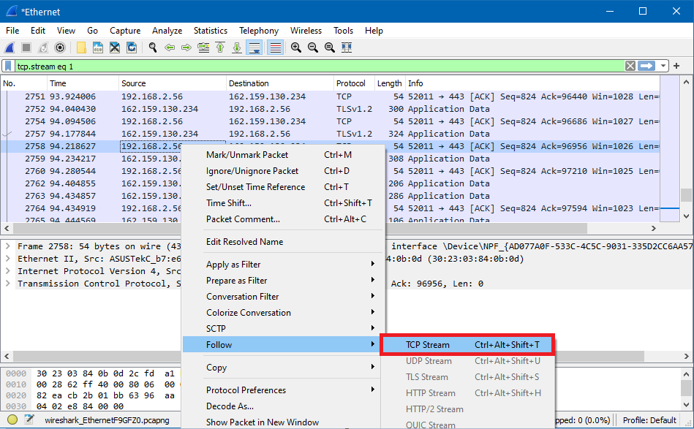
Streams of Packets

Slide 77
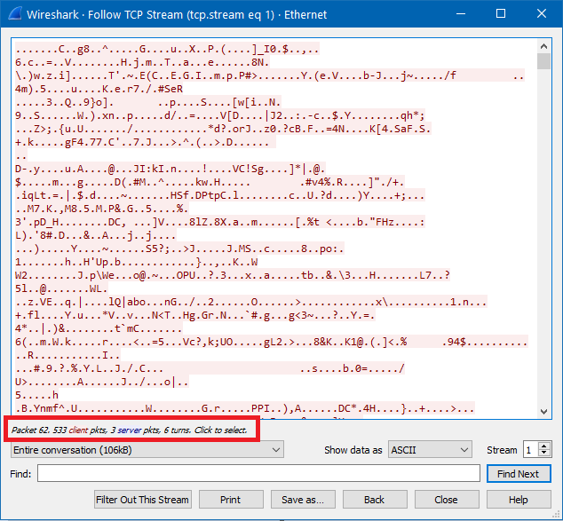
Streams of Packets
In this example, there are 533 client packets and 3 server packets

Slide 78
Uni vs Bidirectional Streams
Scapy's default behavior is to reassemble unidirectional streams.
In other words, two separate sessions are created:
Host A -> Host B
Host B -> Host A
To use scapy's native session reassembly you call a packet lists’ .sessions() method which returns a Python dictionary of followed streams.

Slide 79
Bidirectional Streams
They keys of that dictionary contain a string indicating who is communicating with who in the format:

Slide 80
Bidirectional Streams
Its value in the dictionary is a list of all the packets that are part of that stream
In the following example you can tell by looking at the keys that there are two sessions.
We can just combine the two sets of packets to get our bidirectional stream

Slide 81
Bidirectional Streams
>>>from scapy.all import *
>>>the_pkts = rdpcap ("mypackets.pcap")
>>>the_pkts.sessions().keys()['TCP 10.10.10.10:80 > 10.1.1.1:59202', 'TCP 10.1.1.1:59202 > 10.10.10.10:80’]
>>>the_pkts.sessions()['TCP 10.10.10.10:80 > 10.1.1.1:59202'] <PacketList: TCP:5 UDP:0 ICMP:0 Other:0>
Notes:
from scapy.all import *
the_pkts = rdpcap ("mypackets.pcap")
the_pkts.sessions().keys()['TCP 10.10.10.10:80 > 10.1.1.1:59202', 'TCP 10.1.1.1:59202 > 10.10.10.10:80']
the_pkts.sessions()['TCP 10.10.10.10:80 > 10.1.1.1:59202'] <PacketList: TCP:5 UDP:0 ICMP:0 Other:0>

Slide 82
Payload Extraction

